Slide 1
Introduction to JavaScript: DOM
Week 03.

Slide 2
Objectives
Describe the basic structure of the Document Object Model (DOM);
Describe the way HTML elements can be accessed from the DOM using JavaScript;
Demonstrate how to write scripts in web page using JavaScript to create and control behaviours of the web page.

Slide 3
Tools Required
Visual Studio Code
Browser
Google Chrome (recommended)
Mozilla Firefox

Slide 4
Writing Client Side Javascript

Slide 5
Browsers + JavaScript Consoles
Google Chrome
Console
Chrome Canary: Developer version of Chrome
Firefox
Firebug (Add-on)
Safari
Console: Web Inspector (need to enable Developer mode in Preferences -> Advanced)
Webkit Nightly: Developer version
Internet Explorer
F12 Developer Tools

Slide 6
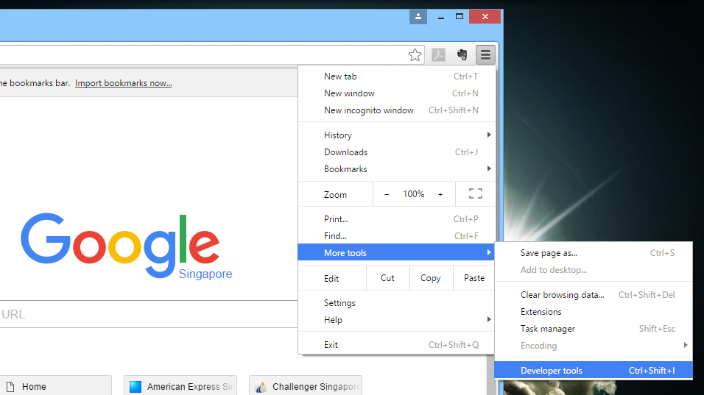
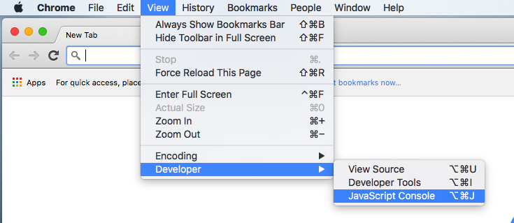
JavaScript Console (Chrome)
You will use a browser built-in tool called JavaScript Console to help you learn JavaScript.
Mac OS X
Windows

Slide 7
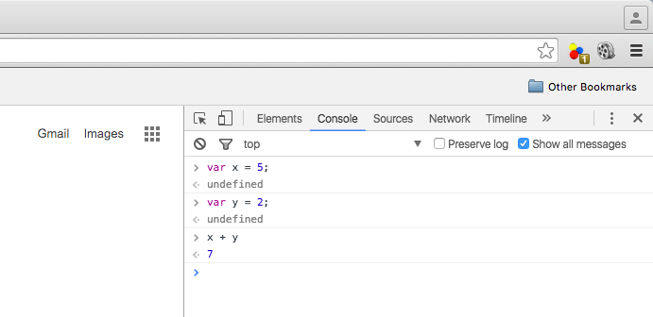
JavaScript Console (Chrome)

Slide 8
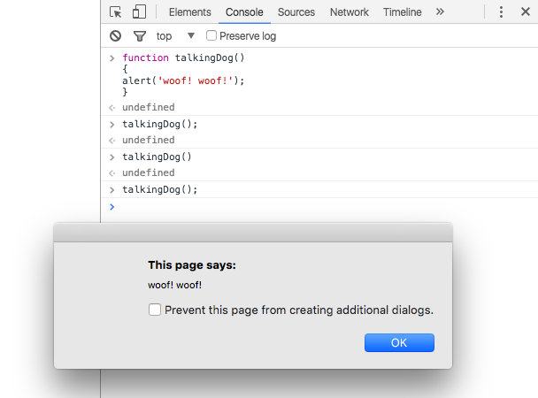
JavaScript Console (Chrome)
You can also write functions in the console.
Type Shift-Enter to go to new line.

Slide 9
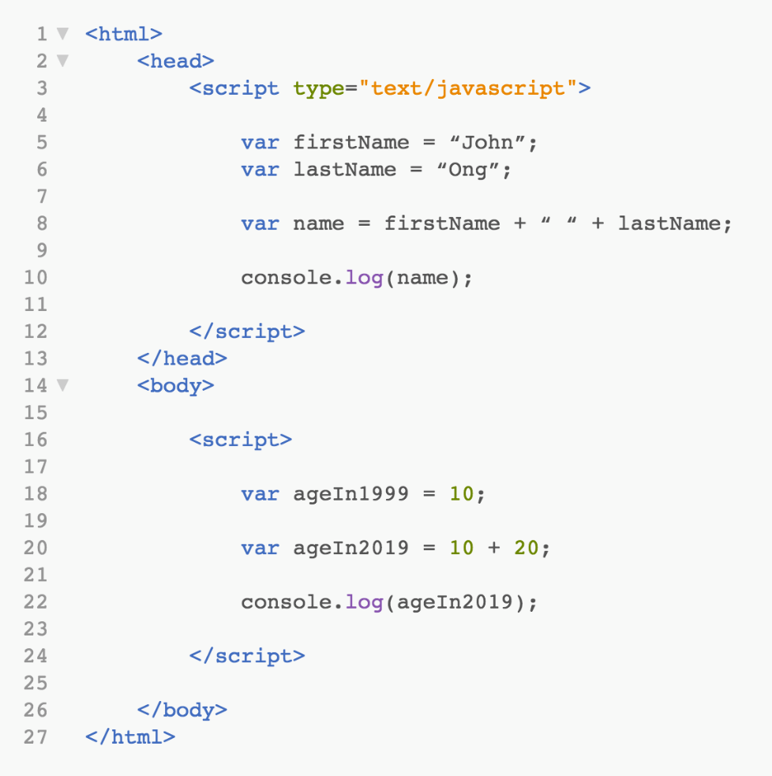
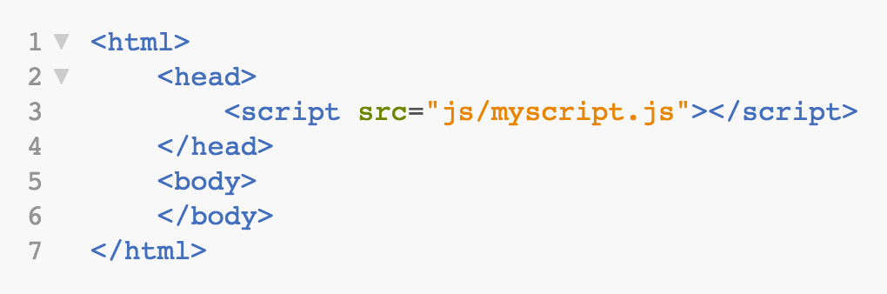
How to Use JavaScript in HTML?
In Script Tag Within
Head/Body Tag
Link to External File

Slide 10
JavaScript References
W3Schools
http://www.w3schools.com/js/default.asp
Mozilla Developer Network
http://developer.mozilla.org/en-US/docs/Web/JavaScript
JavaScript: The Good Parts by Douglas Crockford
Google: Chrome Developer Tools
http://developers.google.com/chrome-developer-tools
Firefox: Firebug Wiki
http://getfirebug.com/wiki

Slide 11
The document object model (DOM)

Slide 12
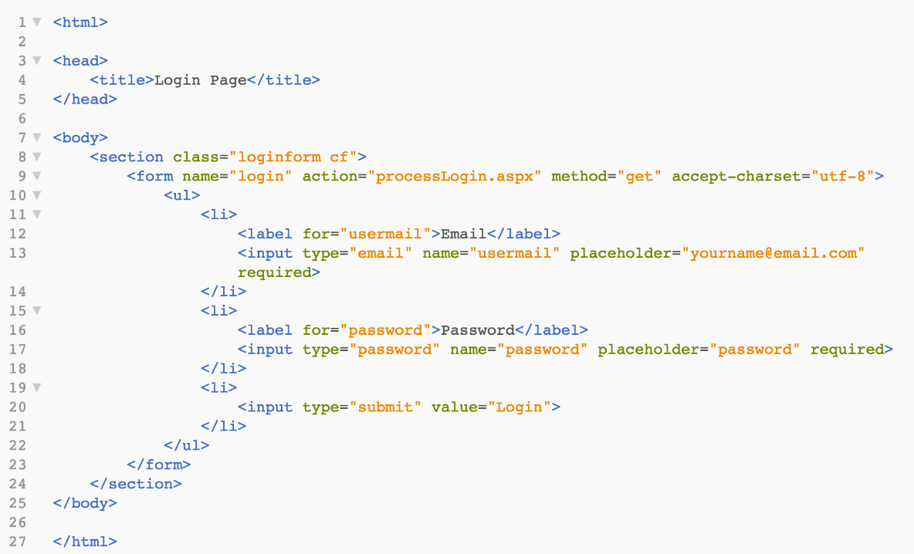
What is DOM?
The HTML DOM (Document Object Model) describes the elements and their hierarchy in a web page.
Using JavaScript, we can access the properties of individual elements in a HTML page with the DOM.

Slide 13
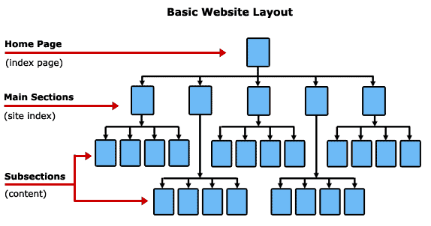
Site Navigation Map
In a website

Slide 14
DOM Hierarchy

Slide 15
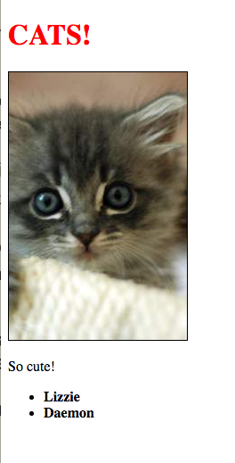
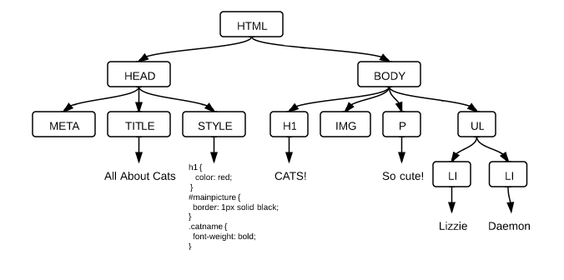
DOM Hierarchy Example

Slide 16
DOM Access: By id
If a HTML has:
We can access the image source using JavaScript by writing:
src=“https://picsum.photos/200/300”

Slide 17
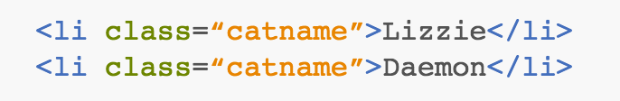
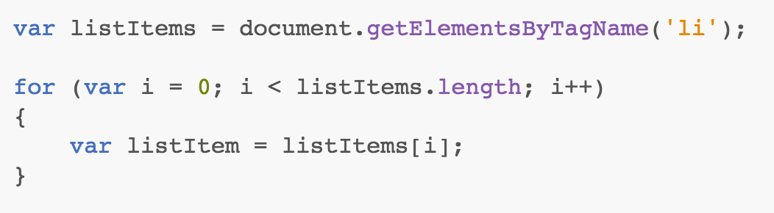
DOM Access: By Tag Name
If a HTML has:
We can access individual cat names using JavaScript by writing:

Slide 18
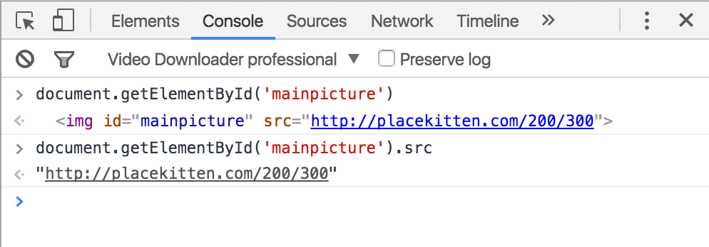
DOM Access: JavaScript Console
You can use the browser’s JavaScript Console to help you to access the elements and their properties correctly.
Type the JavaScript to access a particular element or its properties in a web page and press enter to see the result.
https://picsum.photos/200/300
https://picsum.photos/200/300

Slide 19
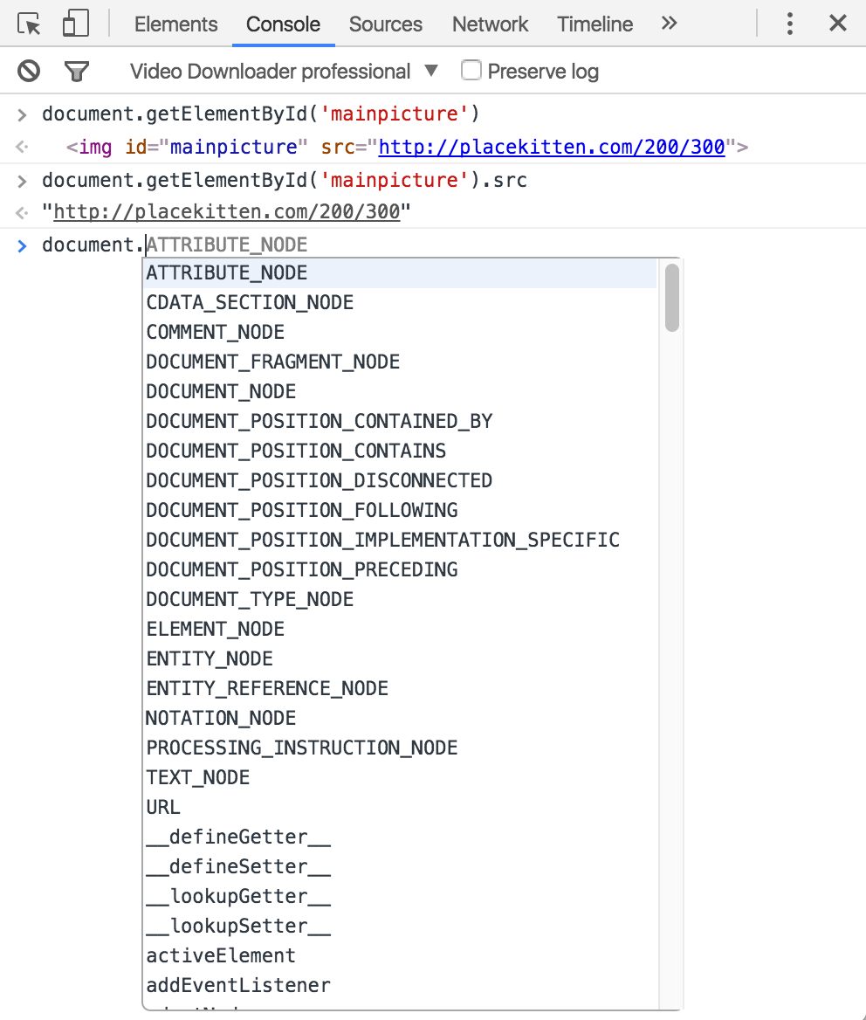
DOM Access: JavaScript Console
As you type the DOM nodes followed by a dot, a list of child nodes will be displayed for you to select.
https://picsum.photos/200/300
https://picsum.photos/200/300

Slide 20
Try It Out!
Open up girldevelopit.com in Chrome or Firefox, and open up the console (CMD-Option-I on Macs).
Use DOM access methods to explore the following parts of the page. You can use Inspect Element to figure out what their tag names, classes, or IDs are.
Every image on the page
The navigation area in the upper right
The MailChimp sign-up form in the bottom
The upper left-hand logo that says GDI (Hint: use CSS descendant selectors)
The logos of the media sources that featured GirlDevelopIt (lifeHacker, TED, etc., at the bottom of the page)
The big heading that says "DON'T BE SHY DEVELOP IT"

Slide 21
Changing DOM PROPERTIES

Slide 22
DOM Nodes: Attributes
You can access and change attributes of DOM nodes.
If a HTML has:
We can create a variable named image and assign the img element to it:
We can change the src attribute in this way:
We can set a CSS class using the property className:
src=“https://picsum.photos/200/300”
var image = document.getElementById(“mainpicture”);
image.src = “https://picsum.photos/100/500”;
image.className = “picture”;

Slide 23
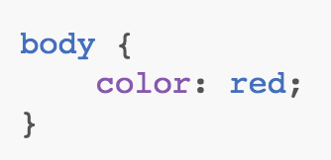
DOM Nodes: CSS Styles
You can change CSS styles via the style property.
If a CSS has:
You can change it in JavaScript in this way:

Slide 24
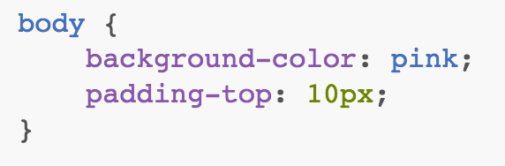
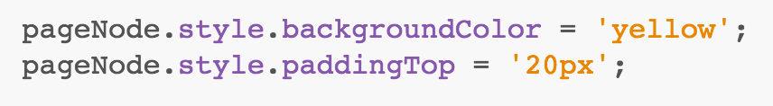
DOM Nodes: CSS Styles
If a CSS has:
You can change it in JavaScript in this way:

Slide 25
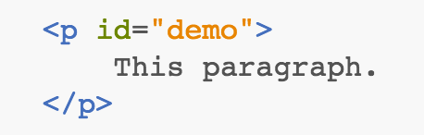
DOM innerHTML
You can change the HTML content of an element using the innerHTML property.
If a HTML has:
You can change the content of <p> in this way:

Slide 26
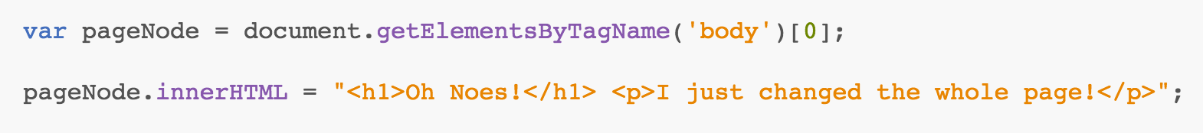
DOM innerHTML
You can also add HTML codes to elements such as the body tag:
Or you can append the content in this way:

Slide 27
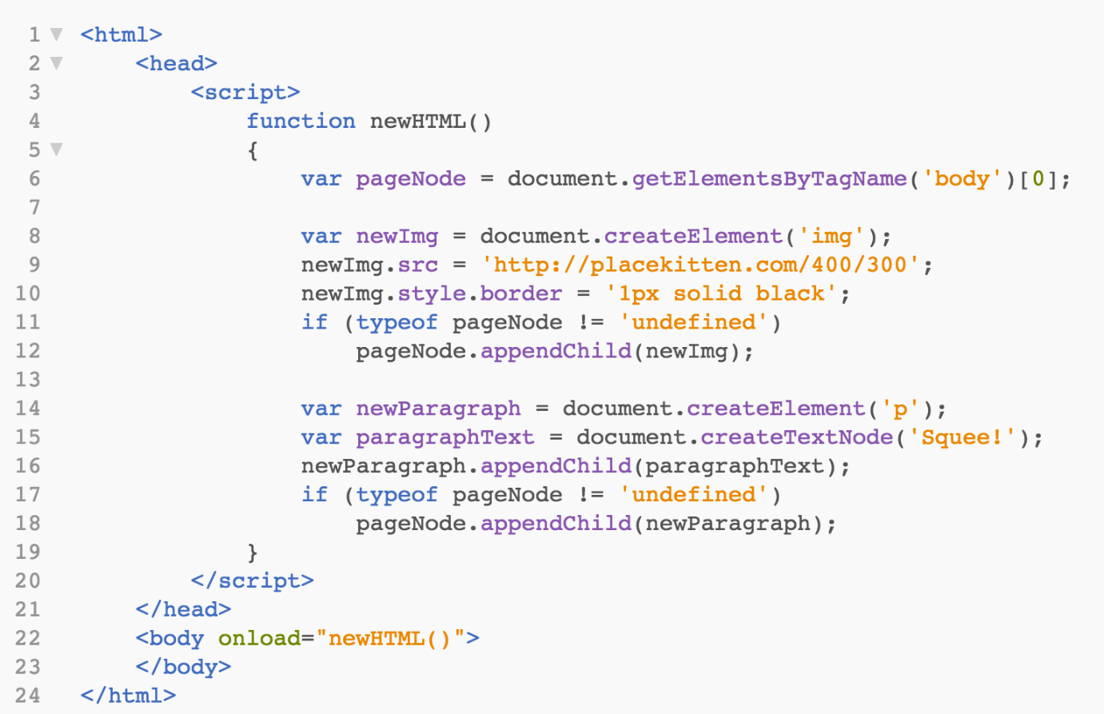
Modifying DOM
The document object also provides ways to create nodes from scratch using JavaScript.
Type the source codes here in a new HTML file and load the file in a browser to see what happens.
‘https://picsum.photos/400/300’;

Slide 28
The End

